Slide 1

MANAGEMENT OF INVENTORY SYSTEMS
Static Inventory Problem under Risk
PROF PRADIP KUMAR RAY
DEPARTMENT OF INDUSTRIAL AND SYSTEMS ENGINEERING
IIT KHARAGPUR

Slide 2
Sub Topics
General Characteristics of the Problem, Types of Problems, Payoff/Outcome for Type-1 Problem
Type-1 Problem: Formulation and Solution, Benefit Analysis
Type-1 Problem: Cost Analysis, Numerical Examples
Type-2 and Type-3 Problems, Numerical Examples, Opportunity Cost Matrix for Type-1 Problems
An Illustrative Example of Variable Demand and Variable Lead Time, Mathematical Formulation for Continuous Demand Distribution
PROF PRADIP KUMAR RAY
DEPARTMENT OF INDUSTRIAL AND SYSTEMS ENGINEERING
IIT KHARAGPUR

Slide 3
Static Inventory Problem under Risk
General Characteristics of the Problem
Types of Problems
Payoff/Outcome for Type-1 Problem
PROF PRADIP KUMAR RAY
DEPARTMENT OF INDUSTRIAL AND SYSTEMS ENGINEERING
IIT KHARAGPUR

Slide 4
General Characteristics of the Problem
This problem is related to a situation where one order is only possible for the inventory item under consideration and demand for the item exists for a specific time period. Exact demand is not known. What is known is demand distribution, in empirical or in standard form. There may be several examples of such a problem.
A newspaper is sold for few hours in a day and its demand is probabilistic. A Christmas tree is sold for a period of say, two weeks in the month of December, and its demand is probabilistic.
PROF PRADIP KUMAR RAY
DEPARTMENT OF INDUSTRIAL AND SYSTEMS ENGINEERING
IIT KHARAGPUR

Slide 5
General Characteristics of the Problem
Items needed for seasonal, religious, and cultural events are modelled as static inventory problem under risk.
This problem, also known as ‘Single Order Quantity’ problem, can be classified according to demand (constant demand, CD or variable demand, VD) and lead time (constant lead time, CLT or variable lead time, VLT).
The problem classification is shown in Figure.
PROF PRADIP KUMAR RAY
DEPARTMENT OF INDUSTRIAL AND SYSTEMS ENGINEERING
IIT KHARAGPUR

Slide 6
General Characteristics of the Problem
CLT
CD
VLT
VD
CLT
Outside Supply
VLT
Single-order
CLT
VLT
Inside Supply
CD
VD
CLT
VLT
PROF PRADIP KUMAR RAY
DEPARTMENT OF INDUSTRIAL AND SYSTEMS ENGINEERING
IIT KHARAGPUR

Slide 7
Types of Problems
Four types of problems may exist:
Constant demand and constant lead time: No need to consider this problem.
Variable demand, constant lead time
Variable lead time, constant demand
Variable demand, variable lead time
These problems need to be formulated and solved
PROF PRADIP KUMAR RAY
DEPARTMENT OF INDUSTRIAL AND SYSTEMS ENGINEERING
IIT KHARAGPUR

Slide 8
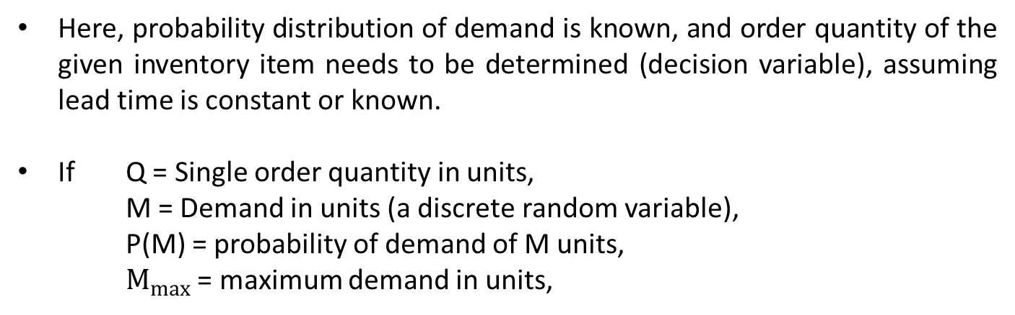
Type-1 Problem: Variable Demand (VD), Constant Lead Time (CLT)
Here, probability distribution of demand is known, and order quantity of the given inventory item needs to be determined (decision variable), assuming lead time is constant or known.
If Q = Single order quantity in units,
M = Demand in units (a discrete random variable),
P(M) = probability of demand of M units,
$M_{max}$ = maximum demand in units,
PROF PRADIP KUMAR RAY
DEPARTMENT OF INDUSTRIAL AND SYSTEMS ENGINEERING
IIT KHARAGPUR

Slide 9
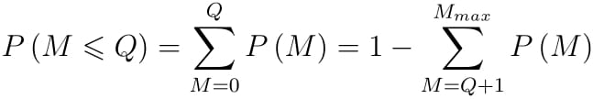
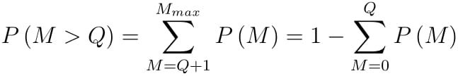
Type–1 Problem: Variable Demand (VD), Constant Lead Time (CLT)
Probability that M ≤ Q is given by
Probability that M > Q is given by
PROF PRADIP KUMAR RAY
DEPARTMENT OF INDUSTRIAL AND SYSTEMS ENGINEERING
IIT KHARAGPUR

Slide 10
Type–1 Problem: Variable Demand (VD), Constant Lead Time (CLT)
Under this problem, the decision variable is the order quantity. There may be a number of possible order quantities referred to as ‘ordering strategies’.
Against each ordering strategy, all possible demand levels need to be considered with their probabilities of occurrence.
Once the number of ordering strategies and the number of possible demand levels are known, we need to determine the expected payoff (either in terms of profit or cost) for each the ordering strategy.
For computation of expected payoff, we need to know the payoff for each combination of order quantity and demand levels. A payoff matrix is accordingly created.
PROF PRADIP KUMAR RAY
DEPARTMENT OF INDUSTRIAL AND SYSTEMS ENGINEERING
IIT KHARAGPUR

Slide 11
Static Inventory Problem under Risk
Type-1 Problem: Formulation and Solution
Benefit Analysis
PROF PRADIP KUMAR RAY
DEPARTMENT OF INDUSTRIAL AND SYSTEMS ENGINEERING
IIT KHARAGPUR

Slide 12
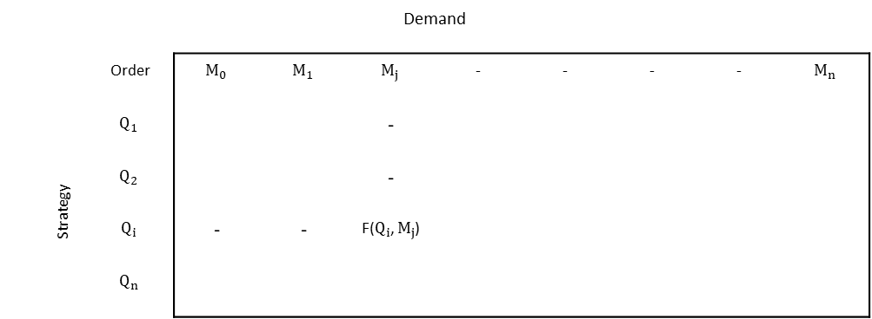
Type–1Problem: Variable Demand (VD), Constant Lead Time (CLT)
The ‘payoff/outcome’ matrix of possible order strategies and demand levels in respect of the given inventory item is given by
Demand
Order Strategy |  |  |  | -
 |  |  |  | -
 |  | - | -
PROF PRADIP KUMAR RAY
DEPARTMENT OF INDUSTRIAL AND SYSTEMS ENGINEERING
IIT KHARAGPUR

Slide 13
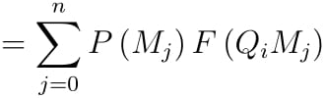
Type–1Problem : Variable Demand (VD), Constant Lead Time (CLT)
The expected value of a demand strategy, $Q_{i }$is given by
Where, = payoff or outcome for order${ Q}_{i }$ and demand $M_{j }$
PROF PRADIP KUMAR RAY
DEPARTMENT OF INDUSTRIAL AND SYSTEMS ENGINEERING
IIT KHARAGPUR

Slide 14
Type–1Problem: Variable Demand (VD), Constant Lead Time (CLT)
The expression of depends on the relationship between ${ Q}_{i }$ and $M_{j }$. There may be two kinds of relationships:
${ Q}_{i }$>${ M}_{j }$(overstock condition) or
${ Q}_{i }$≤ $M_{j }$(understock condition)
If A = stockout cost per unit, B = unit profit or benefit, L = loss from disposal of an overstock unit, P = unit cost, and payoff or outcome is expressed in profit or benefit terms,
PROF PRADIP KUMAR RAY
DEPARTMENT OF INDUSTRIAL AND SYSTEMS ENGINEERING
IIT KHARAGPUR

Slide 15
Type–1Problem: Variable Demand (VD), Constant Lead Time (CLT)
PROF PRADIP KUMAR RAY
DEPARTMENT OF INDUSTRIAL AND SYSTEMS ENGINEERING
IIT KHARAGPUR

Slide 16
Type–1Problem: Variable Demand (VD), Constant Lead Time (CLT)
When payoff or outcome is expressed in cost or sacrifice term,
PROF PRADIP KUMAR RAY
DEPARTMENT OF INDUSTRIAL AND SYSTEMS ENGINEERING
IIT KHARAGPUR

Slide 17
Type–1Problem: Variable Demand (VD), Constant Lead Time (CLT)
When the basis of the problem formulation, as outlined, is known, we may opt for either ‘benefit analysis’ (when sales and profit of the item are considered, an outside supply case) or ‘cost analysis’ (when cost- or production-related data for the item are considered, an inside supply case).
Both these analyses are explained assuming the demand is a continuous variable.
PROF PRADIP KUMAR RAY
DEPARTMENT OF INDUSTRIAL AND SYSTEMS ENGINEERING
IIT KHARAGPUR

Slide 18
Benefit Analysis
Objective: determine order quantity, Q such that expected profit, EP for the period is maximized.
EP = ER – EC
where, ER = Expected Revenue
= Expected Sales Revenue + Expected Salvage Revenue
If $P_{1}$ = unit selling price,
P = unit purchase cost,
C = ordering cost per order,
V = unit salvage value,
f(M) = probability density function of demand, M and
A = stockout cost per unit.
PROF PRADIP KUMAR RAY
DEPARTMENT OF INDUSTRIAL AND SYSTEMS ENGINEERING
IIT KHARAGPUR

Slide 19


Benefit Analysis
PROF PRADIP KUMAR RAY
DEPARTMENT OF INDUSTRIAL AND SYSTEMS ENGINEERING
IIT KHARAGPUR

Slide 20
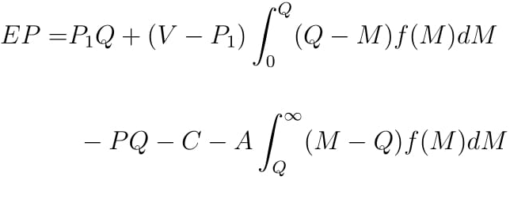
Benefit Analysis
Hence,
PROF PRADIP KUMAR RAY
DEPARTMENT OF INDUSTRIAL AND SYSTEMS ENGINEERING
IIT KHARAGPUR

Slide 21

Benefit Analysis
For maximizing EP (a continuous function), the first derivative with respect to the decision variable, Q is set at zero.
i.e.
PROF PRADIP KUMAR RAY
DEPARTMENT OF INDUSTRIAL AND SYSTEMS ENGINEERING
IIT KHARAGPUR

Slide 22

Benefit Analysis
where, ML = P – V = Marginal loss
MP = P1 – P = Marginal profit
Sufficient condition for maximization:
PROF PRADIP KUMAR RAY
DEPARTMENT OF INDUSTRIAL AND SYSTEMS ENGINEERING
IIT KHARAGPUR

Slide 23
Numerical Example-1
A merchant wishes to stock Christmas trees for sale during the Christmas season. There is only enough time for a single order. Each tree costs $2.00 and sells for $6.00. Ordering costs are negligible, and unsold trees can be sold for $1.00 as firewood. The merchant must order trees in multiples of ten, and the demand distribution during the season is given in table. How many trees should the merchant order?
PROF PRADIP KUMAR RAY
DEPARTMENT OF INDUSTRIAL AND SYSTEMS ENGINEERING
IIT KHARAGPUR

Slide 24
Numerical Example-1
Demand M | Probability P(M)
10 | 0.10
20 | 0.10
30 | 0.20
40 | 0.35
50 | 0.15
60 | 0.10
 | 1.00
PROF PRADIP KUMAR RAY
DEPARTMENT OF INDUSTRIAL AND SYSTEMS ENGINEERING
IIT KHARAGPUR

Slide 25
Solution
A payoff matrix is developed with the profit from each strategy and state of nature. The Expected value of each strategy is obtained by multiplying its probabilities of occurrence by the values of its outcomes and summing the products. The final selection is based on the strategy with the highest expected value. The best strategy is to order 50 trees with the expected value of $127.50
PROF PRADIP KUMAR RAY
DEPARTMENT OF INDUSTRIAL AND SYSTEMS ENGINEERING
IIT KHARAGPUR

Slide 26
Solution
Order Strategy | Probability | 0.10 | 0.10 | 0.20 | 0.35 | 0.15 | 0.10 | Expected Value($)
 | Demand | 10 | 20 | 30 | 40 | 50 | 60
10 |  | 40 | 40 | 40 | 40 | 40 | 40 | 40.00
20 |  | 30 | 80 | 80 | 80 | 80 | 80 | 75.00
30 |  | 20 | 70 | 120 | 120 | 120 | 120 | 105.00
40 |  | 10 | 60 | 110 | 160 | 160 | 160 | 125.00
50 |  | 0 | 50 | 100 | 150 | 200 | 200 | 127.50
60 |  | -10 | 40 | 90 | 140 | 190 | 140 | 122.50
PROF PRADIP KUMAR RAY
DEPARTMENT OF INDUSTRIAL AND SYSTEMS ENGINEERING
IIT KHARAGPUR

Slide 27
Static Inventory Problem under Risk
Type-1 Problem: Cost Analysis
Numerical Example
Type-2 Problem, Numerical Example
PROF PRADIP KUMAR RAY
DEPARTMENT OF INDUSTRIAL AND SYSTEMS ENGINEERING
IIT KHARAGPUR

Slide 28
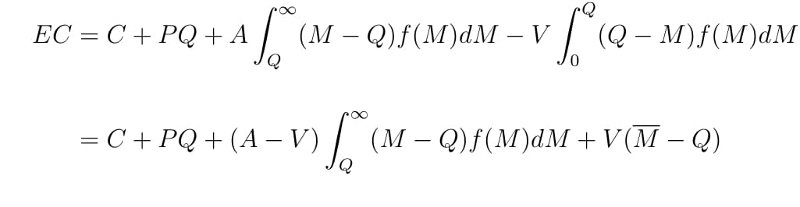
Type-1 Problem: Cost Analysis
This analysis is relevant when inventory items are intended for internal use, mainly for production purpose. We need to minimize total relevant cost against the order quantity (decision variable).
Expected cost is determined considering order cost, purchase cost, stockout cost, and salvage value. Expected cost, EC, is given by
PROF PRADIP KUMAR RAY
DEPARTMENT OF INDUSTRIAL AND SYSTEMS ENGINEERING
IIT KHARAGPUR

Slide 29


Cost Analysis
For minimization of EC,
Sufficient condition for minimization:
PROF PRADIP KUMAR RAY
DEPARTMENT OF INDUSTRIAL AND SYSTEMS ENGINEERING
IIT KHARAGPUR

Slide 30
Numerical Example-1
A large department store has just purchased a new central air conditioning unit. The lifetime of the air conditioner is estimated at 12 years. The manager must decide how many spare compressors to purchase for the unit. If he purchases the compressors now, they will cost $100 each. If he purchases them when they fail, the cost will be $1,000 each. Table gives the probability distribution of the number of failures of the part during the life of the air conditioner, as supplied by the manufacturer. The installation cost of the compressor, as well as its salvage value, is assumed to be negligible.
PROF PRADIP KUMAR RAY
DEPARTMENT OF INDUSTRIAL AND SYSTEMS ENGINEERING
IIT KHARAGPUR

Slide 31
Numerical Example-1
How many compressors should be purchased if the holding cost is neglected? How many compressors should be purchased now if the holding cost, which is mainly the opportunity cost of the money invested, is 10% (assume failures occur at equal intervals-the single failure occur at the end of the 6th year, the two failures occur at the end of the 4th and 8th years, and three failures occur at the end of 3rd, 6th, and 9th years)?
Number of failures, M | Probability | Probability of number of failures > M
0 | 0.30 | 0.70
1 | 0.40 | 0.30
2 | 0.25 | 0.05
3 | 0.05 | 0.00
PROF PRADIP KUMAR RAY
DEPARTMENT OF INDUSTRIAL AND SYSTEMS ENGINEERING
IIT KHARAGPUR

Slide 32
Solution
With holding cost neglected, the cost matrix can be developed, as shown in Table. Since strategy-2 has the lowest expected cost, the manager should order two spare compressors at present time.
Strategy | Probability | 0.30 | 0.40 | 0.25 | 0.05 | Expected Cost ($)
 | State of nature | 0 | 1 | 2 | 3
0 |  | 0 | 1,000 | 2,000 | 3,000 | 1,050
1 |  | 100 | 100 | 1,100 | 2,100 | 450
2 |  | 200 | 200 | 200 | 1,200 | 250
3 |  | 300 | 300 | 300 | 300 | 300
PROF PRADIP KUMAR RAY
DEPARTMENT OF INDUSTRIAL AND SYSTEMS ENGINEERING
IIT KHARAGPUR

Slide 33
Solution
An easier method to obtain the same solution is the expected value approach as follows: $P\left(s\right)=\frac{P−V}{A−V}$ = $\frac{100−0}{1000−0}$ = 0.10
From the given table there are two failures associated with 0.05 stockout probability and one failure with a 0.30 probability, so two compressors should be purchased.
PROF PRADIP KUMAR RAY
DEPARTMENT OF INDUSTRIAL AND SYSTEMS ENGINEERING
IIT KHARAGPUR

Slide 34
Solution
In the case of a holding cost of 10%, the manager must correct his matrix costs according to the time value of money. Consulting a present value table for future single payments results in factors shown in the following table.
Failure at End of Year | Factor
3 | 0.751
4 | 0.683
6 | 0.564
8 | 0.467
9 | 0.424
PROF PRADIP KUMAR RAY
DEPARTMENT OF INDUSTRIAL AND SYSTEMS ENGINEERING
IIT KHARAGPUR

Slide 35
Solution
A payment that must be made in future must be multiplied by the respective time correction factor. The cost matrix is shown in another table. For strategy 0, the cost for state of nature 1 is 0.564(1,000)=564; the cost for nature 2 is 0.683(1,000)+0.467(1,000)=1,150; and the cost of nature 3 is 0.751(1,000)+0.564(1,000)+0.424(1,000)=1,739. The cost of each strategy is obtained in a similar manner. Since strategy-2 results in the lowest expected cost, the manager should order two spare compressors at the present time.
Strategy | Probability | 0.30 | 0.40 | 0.25 | 0.05 | Expected Cost ($)
 | State of nature | 0 | 1 | 2 | 3
0 |  | 0 | 564 | 1,150 | 1,739 | 600.25
1 |  | 100 | 100 | 567 | 1,088 | 266.15
2 |  | 200 | 200 | 200 | 624 | 221.20
3 |  | 300 | 300 | 300 | 300 | 300.00
PROF PRADIP KUMAR RAY
DEPARTMENT OF INDUSTRIAL AND SYSTEMS ENGINEERING
IIT KHARAGPUR

Slide 36
Type–2 Problem:
Constant Demand, Variable Lead Time
In this case, the demand for the given period is known with certainty. However, the lead time is variable (probability distribution of lead time is given).
A lead time can be selected with a high probability of arrival of the order prior to demand.
With stockouts allowed, order is to be placed prior to maximum possible lead time.
With demand remaining same (e.g. demand of steel girders for building construction), a late delivery delays the activity.
PROF PRADIP KUMAR RAY
DEPARTMENT OF INDUSTRIAL AND SYSTEMS ENGINEERING
IIT KHARAGPUR

Slide 37
Numerical Example
The Technology Club plans to sell Christmas trees during the Christmas season. Orders for the trees are to be delivered in specified dates, starting with earliest lot on 1st December. When should the order be placed if an 85% chance of trees arriving on time is desired? The lead time distribution is given in the following table.
Lead Time (days) | Number of Occurrences
10 | 10
11 | 10
12 | 15
13 | 20
14 | 30
15 | 10
16 | 5
 | 100
PROF PRADIP KUMAR RAY
DEPARTMENT OF INDUSTRIAL AND SYSTEMS ENGINEERING
IIT KHARAGPUR

Slide 38
Solution
To satisfy all demand, the largest lead time of 16 days would be selected. Thus, the trees would be ordered 16 days prior to 1st December.
From the table, it is seen that 85% chance of trees arriving on time is desired, the lead time must be 14 days. In this case, the trees should be ordered 14 days prior to December 1.
Lead Time (L) | Probability P(L) | Probability of Lead Time ≤ L
10 | 0.10 | 0.10
11 | 0.10 | 0.20
12 | 0.15 | 0.35
13 | 0.20 | 0.55
14 | 0.30 | 0.85
15 | 0.10 | 0.95
16 | 0.05 | 1.00
PROF PRADIP KUMAR RAY
DEPARTMENT OF INDUSTRIAL AND SYSTEMS ENGINEERING
IIT KHARAGPUR

Slide 39
Static Inventory Problem under Risk
Type-3 Problem
Opportunity Cost Matrix for Type-1 Problem
Numerical Examples
PROF PRADIP KUMAR RAY
DEPARTMENT OF INDUSTRIAL AND SYSTEMS ENGINEERING
IIT KHARAGPUR

Slide 40
Type–3 Problem:
Variable Demand, Variable Lead Time
This is a complex problem.
The problem can be modelled assuming either demand and lead time (i) independent or (ii) dependent with each other.
The problem can be modelled with lead time set at its maximum level.
PROF PRADIP KUMAR RAY
DEPARTMENT OF INDUSTRIAL AND SYSTEMS ENGINEERING
IIT KHARAGPUR

Slide 41
Type–3 Problem:
Variable Demand, Variable Lead Time
If, $\overline{D}$ = average demand per day,
$\overline{L}$ = average lead time length in days,
$σ_{D}$= standard deviation of demand,
$σ_{L}$ = standard deviation of lead time,
σ = standard deviation of demand during lead time,
PROF PRADIP KUMAR RAY
DEPARTMENT OF INDUSTRIAL AND SYSTEMS ENGINEERING
IIT KHARAGPUR

Slide 42


Type–3 Problem:
Variable Demand, Variable Lead Time
When the demand and the lead time distributions are independent:
Average demand during lead time,
Variance of demand during lead time,
PROF PRADIP KUMAR RAY
DEPARTMENT OF INDUSTRIAL AND SYSTEMS ENGINEERING
IIT KHARAGPUR

Slide 43

Type–3 Problem:
Variable Demand, Variable Lead Time
When the demand and the lead time distributions are not independent:
Average demand during lead time,
Variance of demand during lead time,
PROF PRADIP KUMAR RAY
DEPARTMENT OF INDUSTRIAL AND SYSTEMS ENGINEERING
IIT KHARAGPUR

Slide 44
Opportunity Cost Matrix for Type-1 Problem
The ‘payoff’ matrix of the problem can be converted into ‘opportunity’ cost matrix.
The ‘payoff’ can be either of ‘profit’(actually, contribution to profit) or of ‘cost’ term.
The best decision is if order matches exactly with demand, and opportunity cost is zero.
For all other cases, when either order is more or less than the demand, there is an associated opportunity cost.
PROF PRADIP KUMAR RAY
DEPARTMENT OF INDUSTRIAL AND SYSTEMS ENGINEERING
IIT KHARAGPUR

Slide 45
Opportunity Cost Matrix for Type-1 Problem
The relationship between opportunity cost and payoff is given by
EOC = K – EF, if the original payoff matrix is in terms of profit
EOC = EF – K, if the original payoff matrix is in terms of cost
where, EOC = Expected Opportunity Cost for the given strategy (order quantity)
EF = Expected Payoff for the given strategy (order quantity)
K = Expected Value of Payoffs if the best course of action (order matching with demand) is always taken
= a constant
PROF PRADIP KUMAR RAY
DEPARTMENT OF INDUSTRIAL AND SYSTEMS ENGINEERING
IIT KHARAGPUR

Slide 46
Opportunity Cost Matrix for Type-1Problem
We can calculate the EOC for each order quantity. The cost of risk for a particular strategy given by the difference between EOC for the strategy and K
PROF PRADIP KUMAR RAY
DEPARTMENT OF INDUSTRIAL AND SYSTEMS ENGINEERING
IIT KHARAGPUR

Slide 47
An Illustrative Example
x = amount ordered, z = demand level.
The demand distribution is given by
Demand | Probability
1 | 0.05
2 | 0.15
3 | 0.20
4 | 0.40
5 | 0.10
6 | 0.10
 | 1.00
PROF PRADIP KUMAR RAY
DEPARTMENT OF INDUSTRIAL AND SYSTEMS ENGINEERING
IIT KHARAGPUR

Slide 48
An Illustrative Example
Price-cost data: Unit price = 6
Purchase cost = 2
Unit salvage value = 0.5
Unit delivery cost = 0.5
No ordering cost
Payoff matrix is given by
order | Demand
 | 1 | 2 | 3 | 4 | 5 | 6
1 | 3.50 | 3.50 | 3.50 | 3.50 | 3.50 | 3.50
2 | 2.00 | 7.00 | 7.00 | 7.00 | 7.00 | 7.00
3 | 0.50 | 5.50 | 10.50 | 10.50 | 10.50 | 10.50
4 | -1.00 | 4.00 | 9.00 | 14.00 | 14.00 | 14.00
5 | -2.50 | 2.50 | 7.50 | 12.50 | 17.50 | 17.50
6 | -4.00 | 1.00 | 6.00 | 11.00 | 16.00 | 21.00
PROF PRADIP KUMAR RAY
DEPARTMENT OF INDUSTRIAL AND SYSTEMS ENGINEERING
IIT KHARAGPUR

Slide 49
An Illustrative Example
Opportunity cost matrix is given by
order | Demand
 | 1 | 2 | 3 | 4 | 5 | 6
1 | 0.00 | 3.50 | 7.00 | 10.50 | 14.00 | 17.50
2 | 1.50 | 0.00 | 3.50 | 7.00 | 10.50 | 14.00
3 | 3.00 | 1.50 | 0.00 | 3.50 | 7.00 | 10.50
4 | 4.50 | 3.00 | 1.50 | 0.00 | 3.50 | 7.00
5 | 6.00 | 4.50 | 3.00 | 1.50 | 0.00 | 3.50
6 | 7.50 | 6.00 | 4.50 | 3.00 | 1.50 | 0.00
PROF PRADIP KUMAR RAY
DEPARTMENT OF INDUSTRIAL AND SYSTEMS ENGINEERING
IIT KHARAGPUR

Slide 50
Static Inventory Problem under Risk
An illustrative example of Variable Demand and Variable Lead Time
Mathematical Formulation for Continuous Demand Distribution
PROF PRADIP KUMAR RAY
DEPARTMENT OF INDUSTRIAL AND SYSTEMS ENGINEERING
IIT KHARAGPUR

Slide 51
Numerical Example-1
From the distributions given below, determine the lead time demand probability distribution. What is the reorder point for a probability of stockout of 0.20?
Daily Demand D (units) | Probability P(D) | Lead time L (days) | Probability P(L)
0 | 0.30 | 1 | 0.75
1 | 0.50 | 2 | 0.25
2 | 0.20
PROF PRADIP KUMAR RAY
DEPARTMENT OF INDUSTRIAL AND SYSTEMS ENGINEERING
IIT KHARAGPUR

Slide 52
Solution
From the two distributions, it is apparent that demand during lead time can be as low as 0 and as high as 4 (a demand of 2 units on each of 2 lead time days). To determine the probability of each given lead time demand, it is necessary to sum the probabilities of the various ways a specific lead time demand can occur as illustrated below:
Lead time Demand = 0:
1. | First day | 0 Demand | 0.75(0.30) = | 0.2250
2. | First day | 0 Demand | 0.25(0.30) 0.30 = | 0.0225
 | Second day | 0 Demand
 | Total |  |  | 0.2475
PROF PRADIP KUMAR RAY
DEPARTMENT OF INDUSTRIAL AND SYSTEMS ENGINEERING
IIT KHARAGPUR

Slide 53
Solution
Lead time Demand = 1:
1. | First day | 1 Demand | 0.75(0.50) = | 0.3750
2. | First day | 0 Demand | 0.25(0.30) 0.50 = | 0.0375
 | Second day | 1 Demand
3. | First day | 1 Demand | 0.25(0.50) 0.30 = | 0.0375
 | Second day | 0 Demand
 | Total |  |  | 0.4500
PROF PRADIP KUMAR RAY
DEPARTMENT OF INDUSTRIAL AND SYSTEMS ENGINEERING
IIT KHARAGPUR

Slide 54
Solution
Lead time Demand = 2:
1. | First day | 2 Demand | 0.75(0.20) = | 0.1500
2. | First day | 0 Demand | 0.25(0.30) 0.20 = | 0.0150
 | Second day | 2 Demand
3. | First day | 1 Demand | 0.25(0.50) 0.50 = | 0.0625
 | Second day | 1 Demand
4. | First day | 2 Demand | 0.25(0.20) 0.30 = | 0.0150
 | Second day | 0 Demand
 | Total |  |  | 0.2425
PROF PRADIP KUMAR RAY
DEPARTMENT OF INDUSTRIAL AND SYSTEMS ENGINEERING
IIT KHARAGPUR

Slide 55
Solution
Lead time Demand = 3:
1. | First day | 1 Demand | 0.25(0.50)0.20 = | 0.0250
 | Second day | 2 Demand
2. | First day | 2 Demand | 0.25(0.20)0.50 = | 0.0250
 | Second day | 1 Demand
 | Total |  |  | 0.0500
Lead time Demand = 4:
1. | First day | 2 Demand | 0.25(0.20)0.25 = | 0.0100
 | Second day | 2 Demand
PROF PRADIP KUMAR RAY
DEPARTMENT OF INDUSTRIAL AND SYSTEMS ENGINEERING
IIT KHARAGPUR

Slide 56
Solution
The following table contains the joint probability distribution for the lead time demand for the example. A probability of stockout of 0.20 would require a reorder point of 2 units
Lead time Demand (M) | Probability P(M) | P(M > B)
0 | 0.2475 | 0.7525
1 | 0.4500 | 0.3025
2 | 0.2425 | 0.0600
3 | 0.0500 | 0.0100
4 | 0.0100 | 0.0000
 | 1.0000
PROF PRADIP KUMAR RAY
DEPARTMENT OF INDUSTRIAL AND SYSTEMS ENGINEERING
IIT KHARAGPUR

Slide 57
Mathematical Formulation for Continuous Demand Distribution
Depending on the types of costs made available and/or relevant in a given problem, the problem is formulated.
These costs can also be in the form of opportunity cost.
The objective is to determine order quantity when total relevant cost is minimum.
PROF PRADIP KUMAR RAY
DEPARTMENT OF INDUSTRIAL AND SYSTEMS ENGINEERING
IIT KHARAGPUR

Slide 58

Formulation-1
Given $c$(cost per unit) and $C_{u}$ (per unit understock cost), determine order quantity, $x$ with demand density function, $f(y)$ for demand $y.$
Expected cost corresponding to the order quantity, $x$ (${EF}_{x}$) is given by
Taking the first derivative with respect to $x$ (decision variable) and setting it to zero, we get
$$F\left(x\right)= \frac{C_{u }−c}{C_{u }}$$
(applying Leibniz's rule)
PROF PRADIP KUMAR RAY
DEPARTMENT OF INDUSTRIAL AND SYSTEMS ENGINEERING
IIT KHARAGPUR

Slide 59
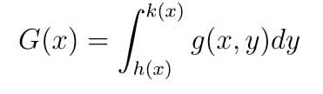
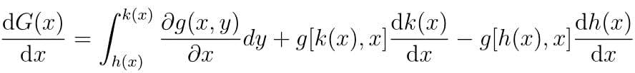
Leibniz's rule
The derivative of any expression of the form:
is given by
This rule will enable us to differentiate all of the integrals which we need for this kind of inventory problems.
PROF PRADIP KUMAR RAY
DEPARTMENT OF INDUSTRIAL AND SYSTEMS ENGINEERING
IIT KHARAGPUR

Slide 60
Formulation-1
Example: Let us assume that, for the given item, demand is normal with mean of 100 (μ) and standard deviation of 20 (σ), $c$ = 100, $C_{u}$ = 1,000,
$F\left(x\right)= \frac{1000−100}{1000}$ = 0.9
Reference to a standard normal distribution table, we get a value of z = 1.28 against $F\left(x\right)$ = 0.90. Hence, order quantity,
$x$ = μ + z.σ
= 100 + 1.28 × 20 = 125.6 $≈$ 126
PROF PRADIP KUMAR RAY
DEPARTMENT OF INDUSTRIAL AND SYSTEMS ENGINEERING
IIT KHARAGPUR

Slide 61

Formulation-2
Given $K_{o}$= opportunity cost of one unit of overstock, $K_{u}$= opportunity cost of one unit of understock, order quantity is $x,$and $y$ is the demand with its probability density function $f(y)$, the expected relevant cost for ordering $x$ units is given by
Taking the first derivative with respect to $x$ (decision variable) and setting it to zero for minimization of expected cost, we get
$$F\left(x\right)= \frac{K_{u}}{K_{o}+K_{u}}$$
PROF PRADIP KUMAR RAY
DEPARTMENT OF INDUSTRIAL AND SYSTEMS ENGINEERING
IIT KHARAGPUR

Slide 62

Formulation-2
Since both the formulations refer to the same problem, the relationship between opportunity costs and total costs are given as
$K_{o}$= $c$
$K_{u}$= $C_{u}$- $c$
Other costs, as considered relevant, can also be considered in problem formulation. For example, if we consider a salvage value, $C_{s}$ per unit unused or unsold, the expected cost equation becomes
PROF PRADIP KUMAR RAY
DEPARTMENT OF INDUSTRIAL AND SYSTEMS ENGINEERING
IIT KHARAGPUR

Slide 63
Formulation-2
With first derivative with respect to $x$ set at zero for minimization of expected cost, we get the solution of the problem as
$$F\left(x\right)= \frac{C_{u}−c}{C_{u}−C_{s}}$$
As it goes, there can be different formulations of the static inventory problem under risk depending on the types of demand distribution we assume and the types of relevant costs we consider.
PROF PRADIP KUMAR RAY
DEPARTMENT OF INDUSTRIAL AND SYSTEMS ENGINEERING
IIT KHARAGPUR

Slide 64
List of Reference Textbooks
Starr, M K and Miller, D W, Inventory Control: Theory and Practice, Prentice Hall.
Tersine, R J, Principles of Inventory and Materials Management, PTR Prentice Hall.
Silver, E A, Pyke, D F and Peterson, R, Inventory Management and Production Planning and Scheduling, John Wiley.
Prof Pradip Kumar Ray
Department of Industrial and Systems Engineering

Slide 65
Thank You!!

